Slide 1

Understanding Protein Sequences with ProtBERT
ProtBERT revolutionizes protein sequence analysis by applying cutting-edge natural language processing techniques.

Slide 2
Team Members
Anshuman Rath: 22BAC10002
Pratham Verma: 22BAC10005
Riteek Panigrahi: 22BAC10012
M K Kiriti: 22BAC10016
Priyanshu Kumar Singh: 22BEC10006
Aman Singh: 22BEC10010

Slide 3
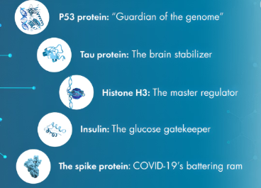
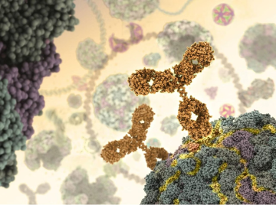
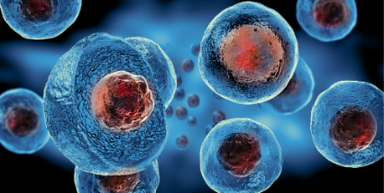
Why ProtBERT?
Classifying Proteins Based on Their Functions
Identifying Binding Sites
Predicting Subcellular Localization
Binding sites are specific regions on a protein where interactions with other molecules occur. They help in finding where virus etc. can bind to our cells.
Subcellular localization refers to the specific location within a cell where a protein is found nucleus, mitochondria, or cytoplasm. It's useful for protein function and cellular processes.
It involves categorizing proteins into functional groups based on their roles in biological processes.

Slide 4

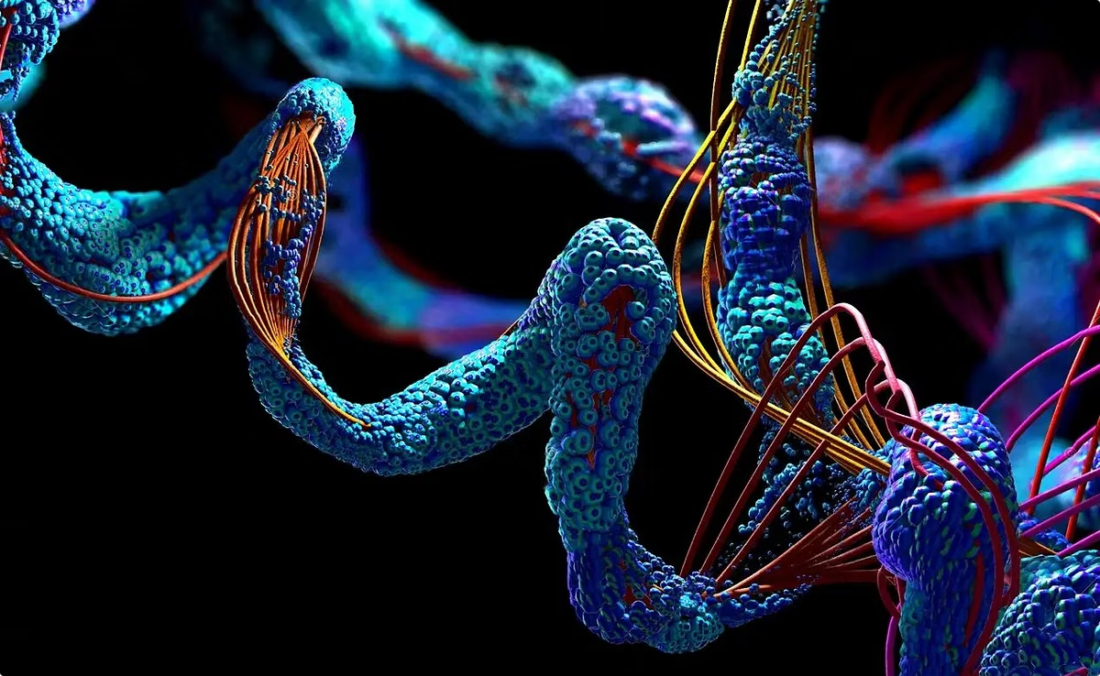
Amino Acids: The building blocks
Amino Acids are the organic compounds that combine to form proteins; hence they are referred to as the building components of proteins.

Slide 5
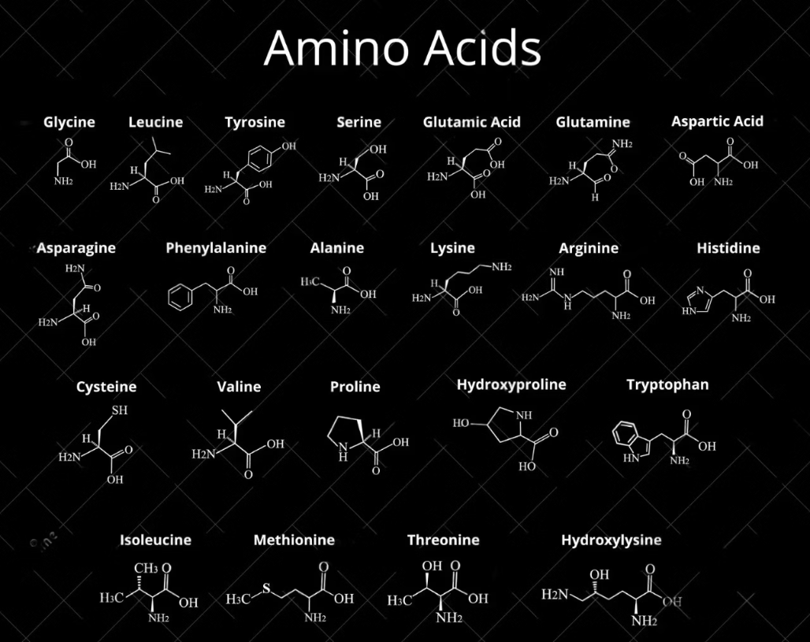
List of Amino Acids:

Slide 6
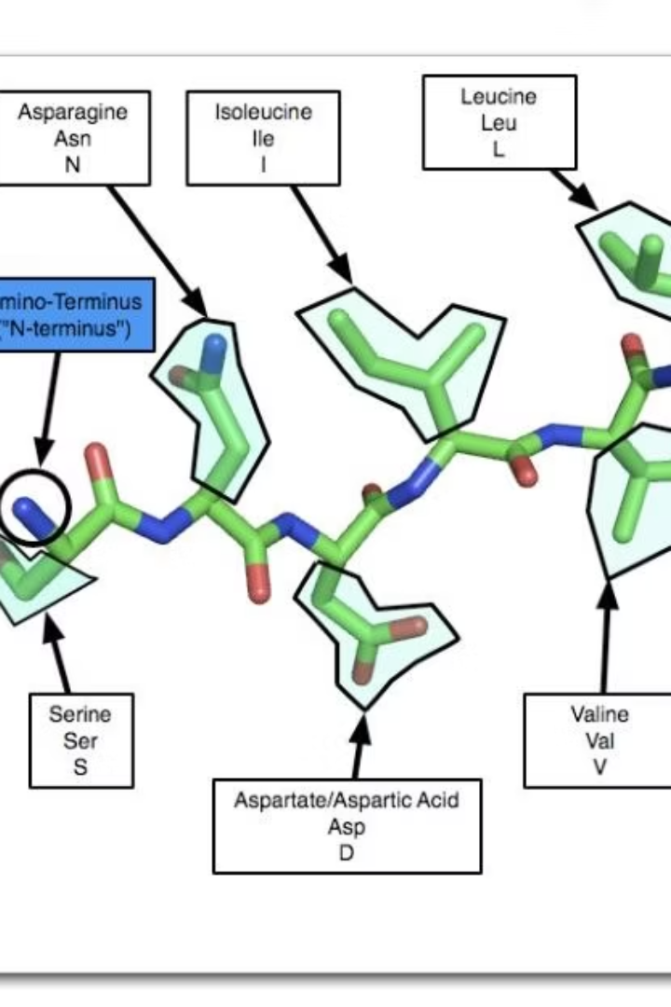
Protein sequence
There are 20 different amino acids that can be combined in various sequences to form proteins. Each amino acid has a unique side chain (R group) that determines its properties.
For example, in a protein sequence:
MKTAYIAKQRQISF
Each letter represents an amino acid

Slide 7
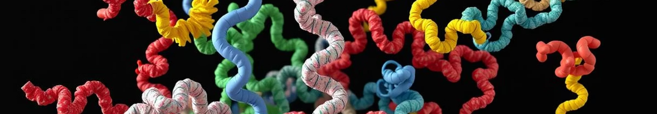




What Protein does?
Understanding binding sites also helps us to diagnose disease and also create drugs
Catalysis
Transport
Enzymes speed up biochemical reactions.
Hemoglobin carries oxygen in the blood.
Structure
Defense
Collagen provides structural support in tissues.
Antibodies protect against foreign invaders.

Slide 8
Protein and text
Protein sequence is just a sequence of amino acids which are letters and sentences are just sequence of words. We use Natural Language Processing to process text using transformers, word encoders: BERT, decoders ect. So to analyze protein sequence we can use the same tools like BERT on these Protein sequences.

Slide 9
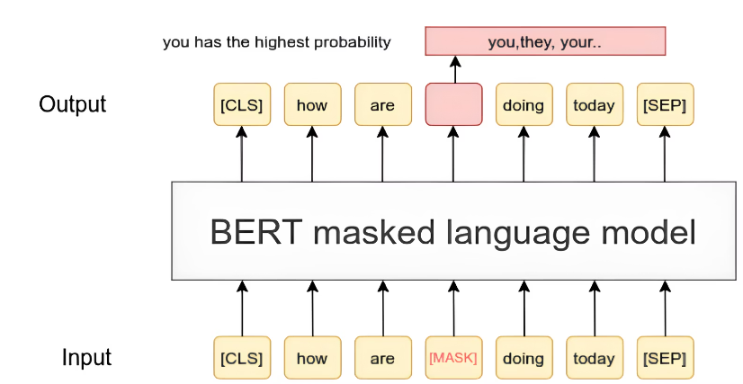
BERT: Bidirectional Encoder Representations from Transformers
BERT is a powerful tool used in Natural Language Processing to analyze and process text data efficiently.
In ProtBERT we use amino acids as inputs and output is completed sequence.
During training, ProtBERT uses a technique called masked language modeling. In this approach, certain amino acids in a sequence are randomly hidden (masked)

Slide 10
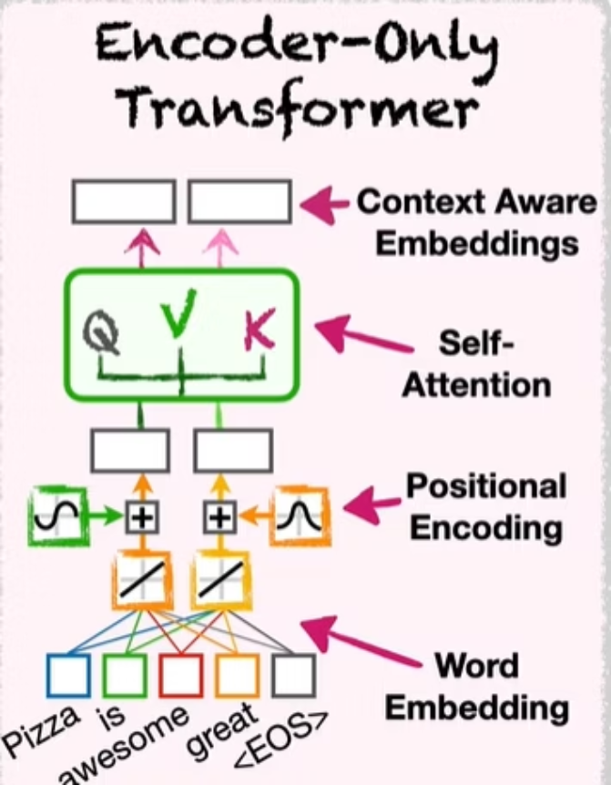
BERT: Deep Learning for NLP
Word Embeddings
Represent letters as vectors.
Positional Encoding
Capture letters order.
Self-Attention
Learns relationship between words (for ProtBERT its letters)

Slide 11
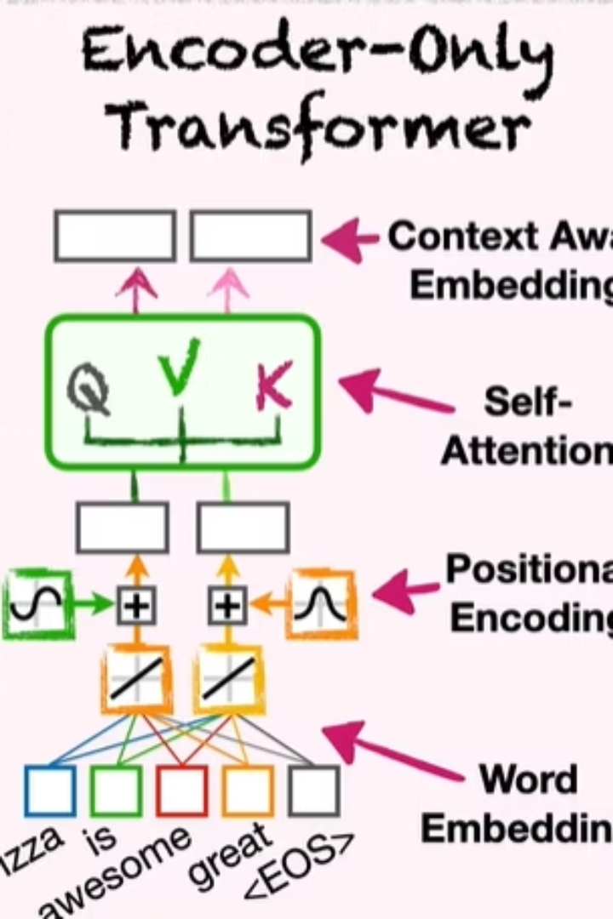

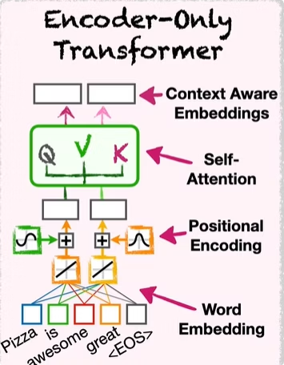
How BERT Works: Key Layers
Word Embeddings
Positional Encoding
Represent words as vectors.
Capture word order.
Transformer Layers
Learns relationship between words (for ProtBERT its letters)

Slide 12

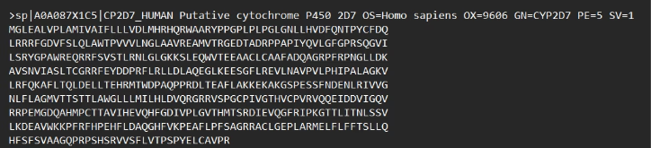
About Dataset
We took dataset from UniPort
UniProt database is a leading resource for protein sequence and functional information. It provides a comprehensive and freely accessible collection of data that includes details about protein sequences, their functions etc.
About Dataset:
FASTA Format
One dataset has two lines:
There were 3 types of formats (text, xml) we choose FASTA as it is a widely accepted and efficient way to represent protein sequences. The FASTA format is specifically designed for biological sequences.
Header Line: Starts with >, followed by an identifier and additional information (e.g., species, gene name).
Sequence Lines: The actual protein or amino acid sequence, which can span multiple lines.

Slide 13
Dataset Example
> sp|A0A087X1C5|CP2D7_HUMAN Putative cytochrome P450 2D7 OS=Homo sapiens OX=9606 GN=CYP2D7 PE=5 SV=1 MGLEALVPLAMIVAIFLLLVDLMHRHQRWAARYPPGPLPLPGLGNLLHVDFQNTPYCFDQ…
sp
sp stands for Swiss-Prot : it means the protein sequence is manually curated and not TrEMBL (not reviewed)
A0A087..
This is the accession number, a unique identifier for this specific protein entry. If the entry were from a different database, it might have a different format or prefix.
CP2D7_HUMAN
This is the protein name or identifier, and suffix reflects the species
Putative cytochrome
This is a detailed description of the protein, indicating its function or role here its role is in drug metabolism and the oxidation of organic substances (cytochrome P450 enzyme family)
OS
This indicates the organism source of the protein, specifying that it is derived from humans
OX=9606
This is the taxonomic identifier (TaxID) for the organism, a unique number assigned by the NCBI to represent species in a standardized way. In this case, 9606 corresponds to humans
GN=CYP2D7
This denotes the gene name associated with the protein, indicating that it is encoded by the CYP2D7 gene.
PE=5
This represents the protein existence evidence level,
0: Predicted. 1: Evidence at protein level to 5: Evidence at protein level from multiple sources.
SV=1
This indicates the sequence version, which is useful for tracking changes or updates to the protein sequence over time. A version number of 1 means its original and 4 means this is the fourth iteration of the sequence.

Slide 14

Future Scope
Technique
Description
Enhanced Predictive Accuracy
Training on large data set
Integrate with other omics data
Predictions with other omics data, such as genomics ect
Multi-Modal Training (data)
Combing protein sequences with other types of biological data, such as structural information
Improving Interpretability
Visualization tools of data and predictions

Slide 15
Thank You!!!

